Slide 1
Requirement Tracebility

Slide 2
Requirements traceability refers to the capability of a requirements management process or tool which enables the process participant or tool user to follow the life of a requirement both forwards and backwards.
It also refers the the ability to link requirements (via specific relationships) to other constructs or artifacts of the product developmetnt lifecycle.
Here are some examples of common requirements traceability relationships:
business goal -> detailed requirement
detailed requirement -> test script
detailed requirement -> system component

Slide 3
Customer needs are traced forward to requirements, so that you can tell which requirements will be affected if those needs change.
A requirement may be traced in one of four distinct ways:
Conversely, you can trace backward from requirements to customer needs to identify the origin of each software requirement.
You can trace forward from requirements by defining links between individual requirements and specific product elements.
Specific product elements [may be traced] backward to requirements so that you know why each item was created.
Requirements may also be traced to other related requirements. So quite simply, requirements traceability traces relationships between requirements in a set, between business needs and corresponding requirements, and between requirements and the various deliverables of a project.

Slide 4
Importance of Requirements Traceability
It ensures that final deliverables directly tie to initial business needs.
Done properly, it ensures that organizations do not waste time and resources repeating research.
It complies with established industry standards.
It offers much easier impact analysis.

Slide 5
Requirement Traceability Matrix (RTM)
It is a document that maps and traces user requirement with test cases.
It captures all requirements proposed by the client and requirement traceability in a single document, delivered at the conclusion of the Software devlopement life cycle.
The main purpose of Requirement Traceability Matrix is to validate that all requirements are checked via test cases such that no functionality is unchecked during Software testing.

Slide 6
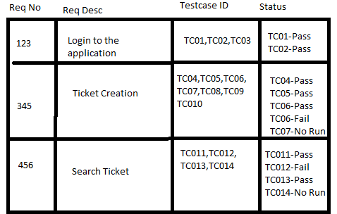
For eg.
Requirement ID
Requirement Type and Description
Test Cases with Status

Slide 7
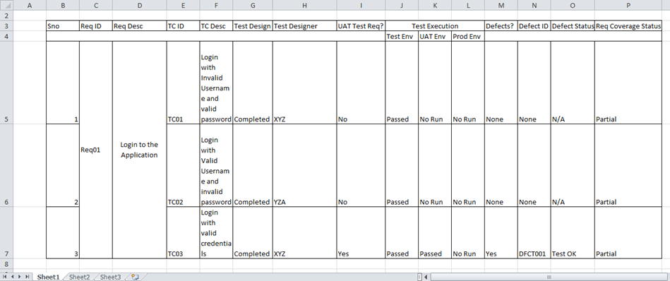
But in a typical software testing project, the traceability matrix would have more than these parameters.

Slide 8
A requirement traceability matrix can:
Show the requirement coverage in the number of test cases
Design status as well as execution status for the specific test case
If there is any User Acceptance test to be done by the users, then UAT status can also be captured in the same matrix.
The related defects and the current state can also be mentioned in the same matrix.

